Slide 1
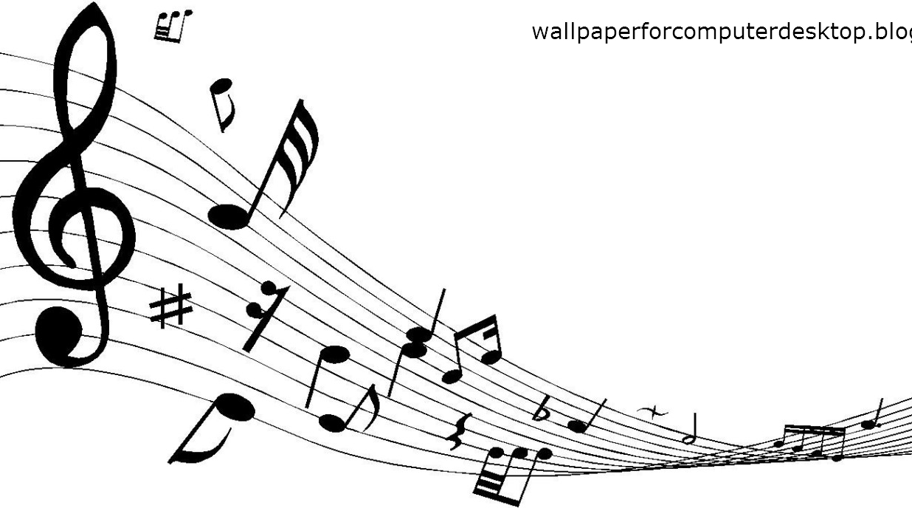
Fractal Music and Musical Fractal
Aashay Vanarase | Adefemi Owoyele | Madhavun Candadai

Slide 2
What we have done?
We have analyzed western classical music from a complex systems perspective…
Note recurrence intervals
Frequency shifts
Structural dynamics
Pitch distribution
Notes:
Specifically by mozart k155 and bach bwv256
Among several aspects we chose note recurrence frequency

Slide 3
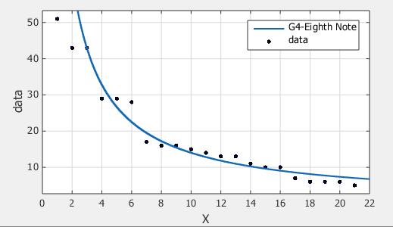
How did we do it?
Identify note
Find recurrence intervals
Rank them
Plot in log-log scale / curve fitting

Slide 4
What we saw?
PIECE | NOTE | Slope | Beta
Bach/ BWV261 | B4 Eighth | 0.5227 | 1.913143
 | D4 -Quarter | 0.7149 | 1.398797
 | E3-Eighth | 0.7272 | 1.375138
 | G4-Eighth Note | 0.5839 | 1.712622
 | F4-sharp Eighth | 0.5598 | 1.786352
 | D5 Quarter | 0.502 | 1.992032
 | G4 -Quarter | 0.5932 | 1.685772
 | G3 -Quarter | 0.6342 | 1.57679
 | C5-Sharp Eighth | 0.8196 | 1.220107
Mozart/ K155 | A4 Eighth Note | 0.7761 | 1.288494
 | A4 Quartet Note | 0.8082 | 1.237317
 | B4 16th Note | 0.611 | 1.636661
 | D5 16th Note | 0.5817 | 1.719099
 | E5 16th Note | 0.6532 | 1.530925
 | F5-sharp 16th Note | 0.7761 | 1.288494
 | G4 Dotted Eighth Note | 0.6072 | 1.646904
 | F4-sharp 32nd Note | 0.5778 | 1.730703
 | G4 32nd Note | 0.5778 | 1.730703

Slide 5
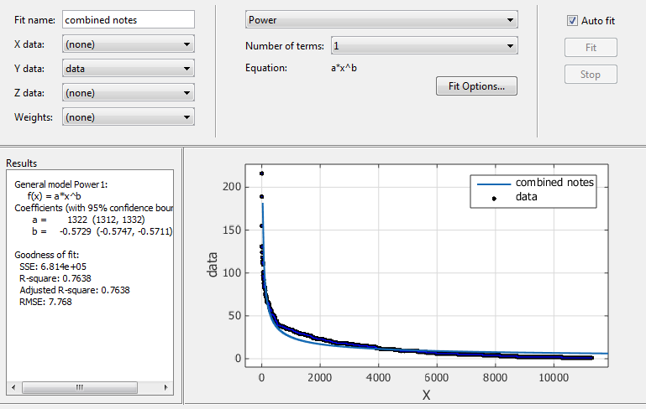
What we saw?

Slide 6
What did we use to do it?
MusicXML
Standard for representing music data in XML
Music21
Python based toolkit from MIT for musicology
Myriad plug-in
Browser plug-in to read and playback from musicXML files

Slide 7
What did we also do?
We assembled a musical score from the known power law distributed set of notes.
Steps
Create number series
Form notes for each number
Create the musicXML file
Prepare HTML for playback

Slide 8


Witness that!

Slide 9
What inspired us?
[1]. Harlan Brothers, Structural Scaling in Bach’s cello suite no. 3, Fractals 2007, 89-95.
[2]. Kenneth Hsu, Andreas Hsu, Fractal Geometry of music, Proceedings of National Academy of Science, USA, Vol. 87,February 1990, 938-941.

Slide 10
What next?
Only one aspect of music is analyzed here
Different genres
Different native styles of music across the world
Creating music based on other aspects

Slide 11
Thank You!! Questions or Comments??

